Slide 1
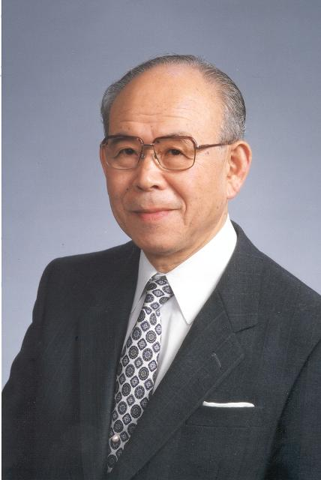
Isamu Akasaki
Notes:
# Name Isamu Akasaki # Textbook Knight, Physics for Scientists and Engineers: A Strategic Approach with Modern Physics, 3rd Edition, Chapter 30 #Contributors # Description The main contribution of Isamu Akasaki is in the semiconductor field. He, along with Hiroshi Amano and Shuji Nakamura invented efficient blue light-emitting diodes, and won the 2014 Noble Prize in Physics. He worked on GaN to make high-brightness blue LED light. As a result, people are able to have bright white LED light as an energy-saving light source. # Sources "Isamu Akasaki." Isamu Akasaki - Engineering and Technology History Wiki, http://ethw.org/Isamu_Akasaki. "Isamu Akasaki." Wikipedia, Wikimedia Foundation, 4 Oct. 2017, http://en.wikipedia.org/wiki/Isamu_Akasaki. # Photo http://ethw.org/w/images/7/7c/Isamu_Akasaki_2482.jpg

